Slide 1


Node Js and why?

Slide 2

| Node.js
> Dependencies and Package Manager

Slide 3

| Node.js

Slide 4
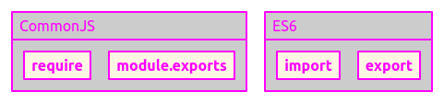
| Node.js
> Module Systems

Slide 5
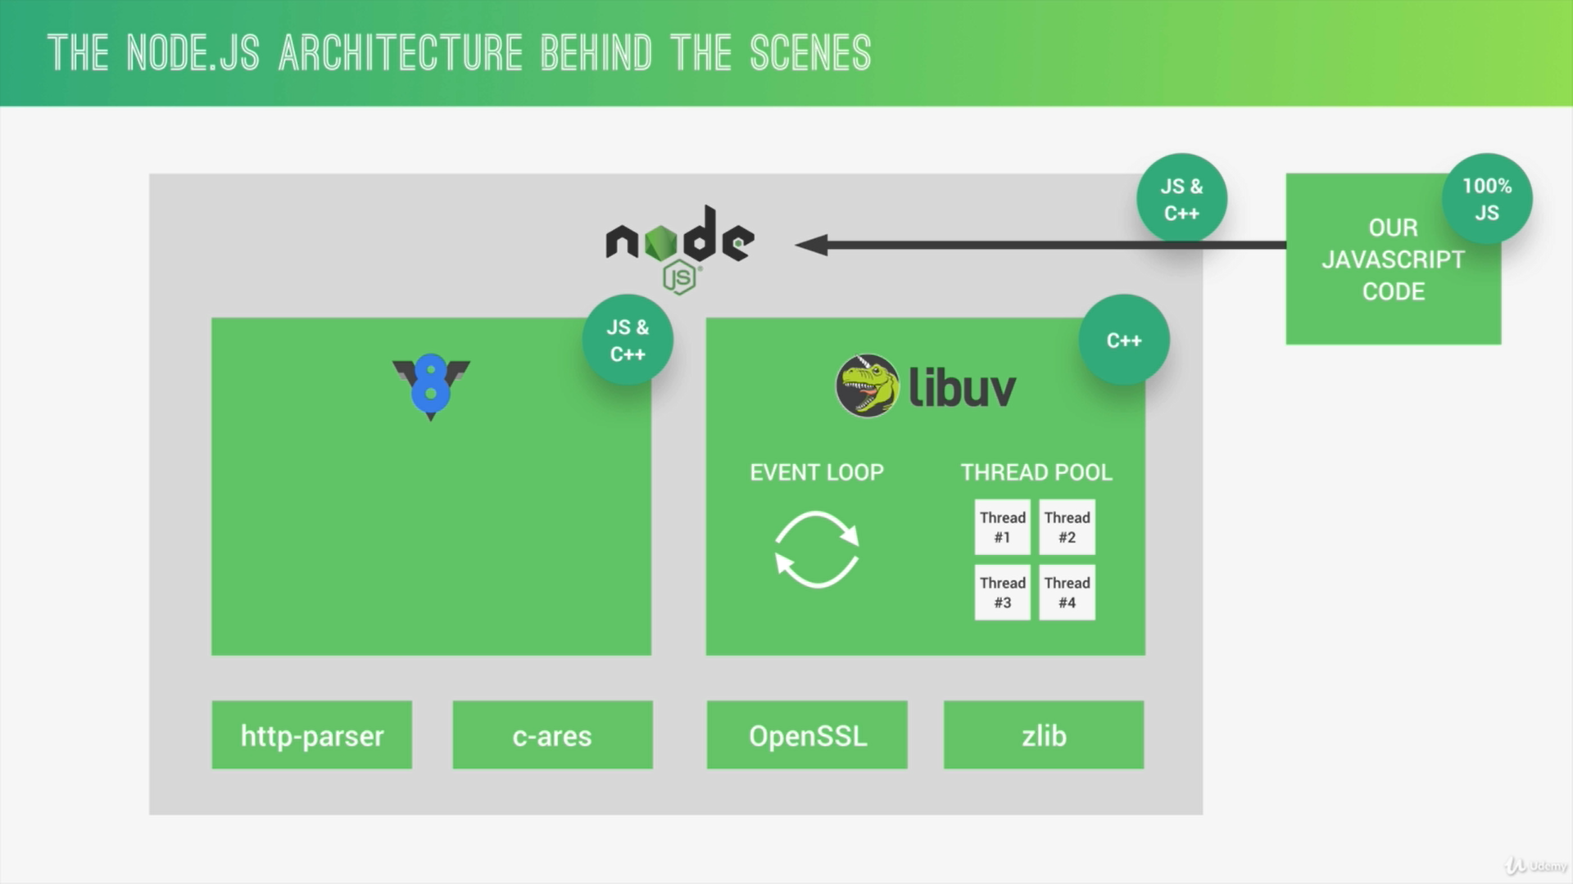
Notes:
Resources and videos:
https://youtu.be/jXPoqwO3ygI
https://stackoverflow.com/questions/42616120/what-is-the-relationship-between-node-js-and-v8#:~:text=V8%20is%20the%20Javascript%20engine%20inside%20of%20node.js,Chrome%20to%20run%20javascript%20in%20the%20Chrome%20browser.

Slide 6
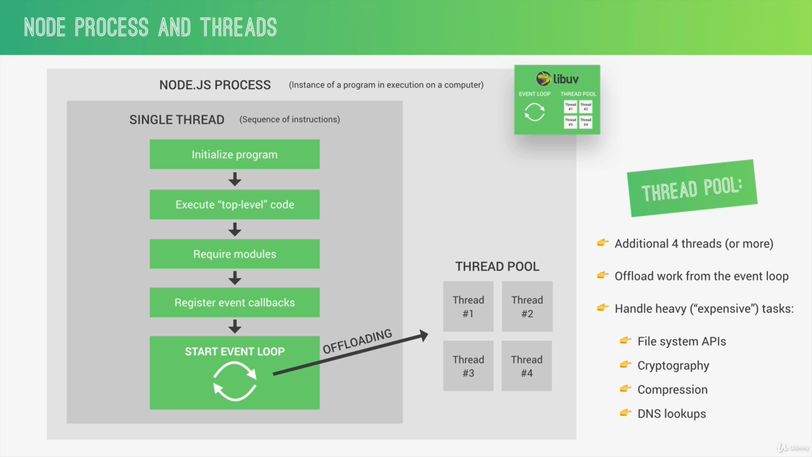

Slide 7
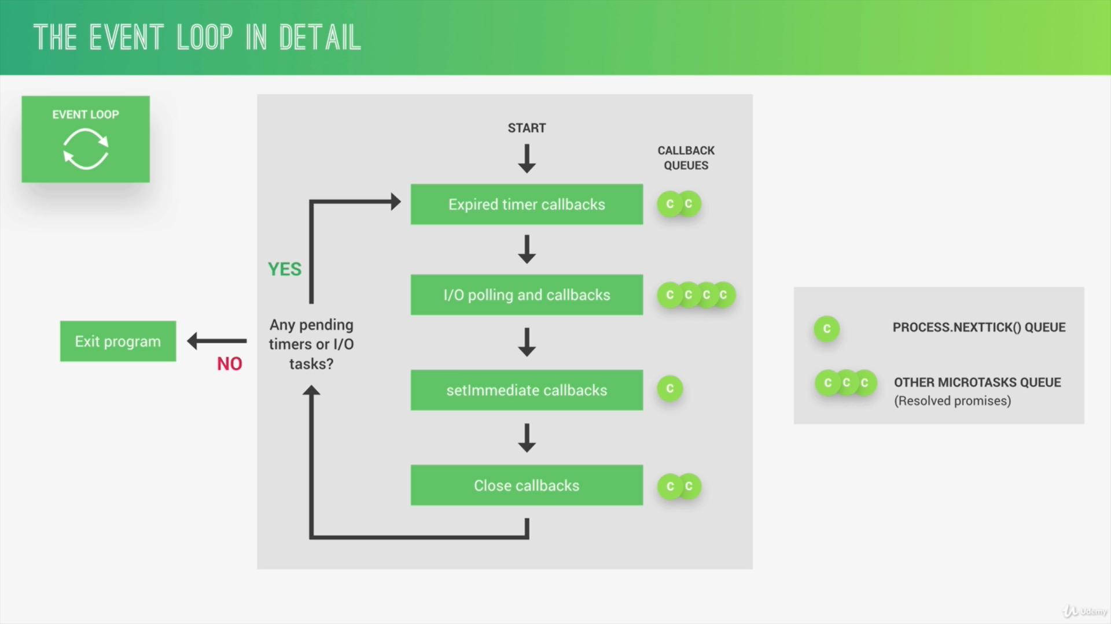
Notes:
Resources:
https://javascriptbit.com/what-is-the-event-loop-in-javascript/

Slide 8
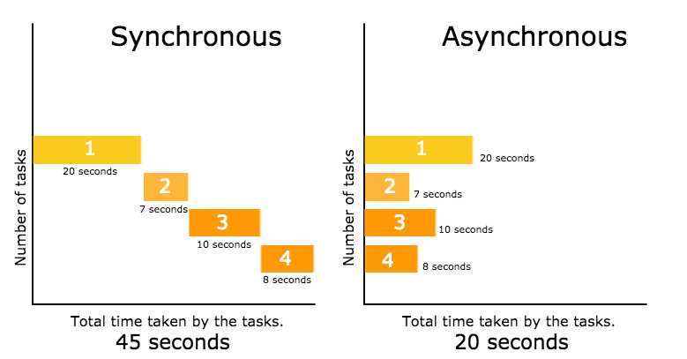

Slide 9
REST API ?

Slide 10
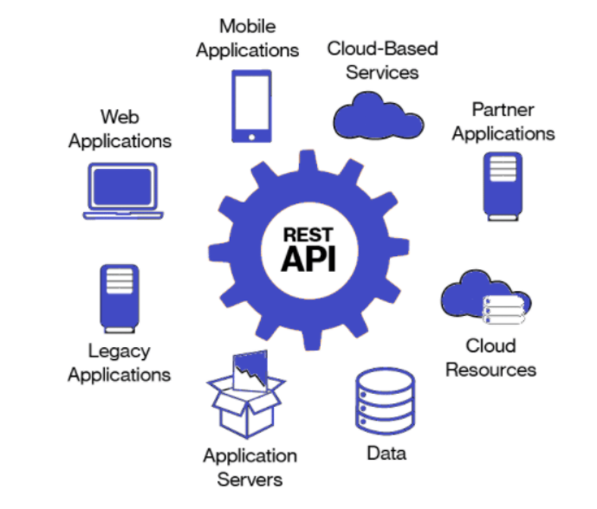

Slide 11


Slide 12
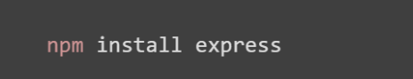
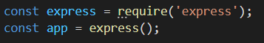
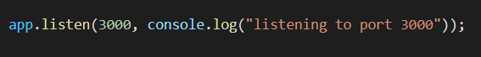
Express
Notes:
Resources: https://expressjs.com/en/5x/api.html

Slide 13
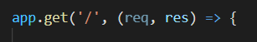
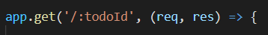
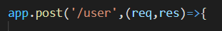
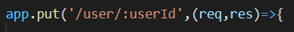
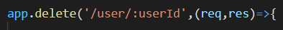
End Points

Slide 14
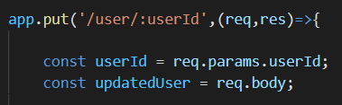
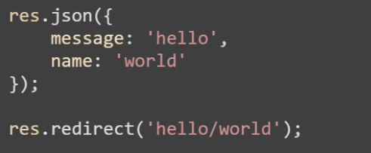
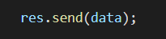
Requests and responses

Slide 15
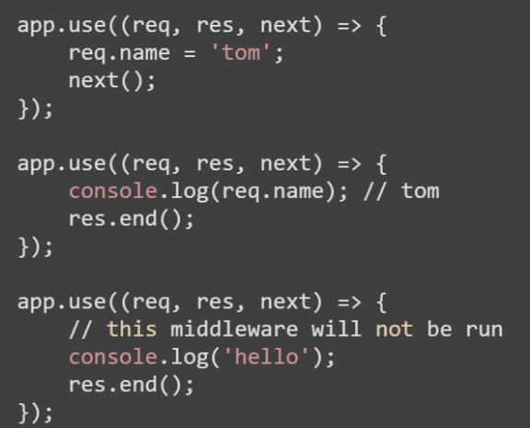
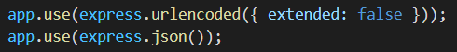
Middlewares

Slide 16
Demo Time!

Slide 17


Slide 18
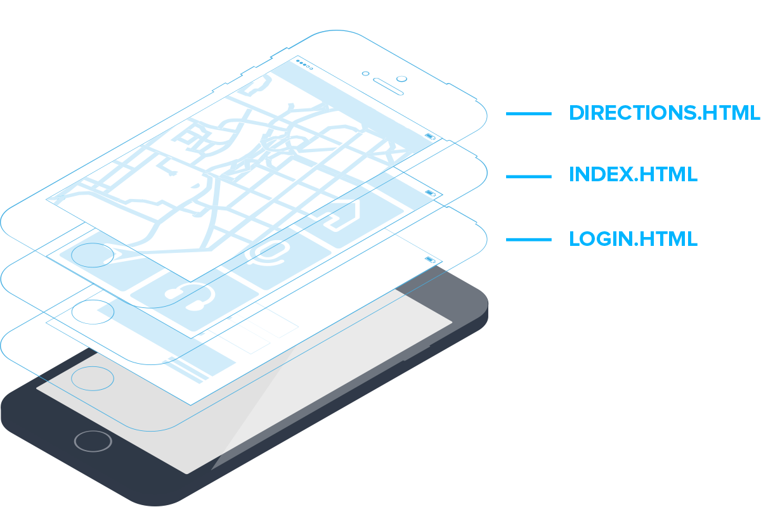
Multi Page Applications

Slide 19


Single Page Applications
Notes:
Resources:
https://www.codeinwp.com/blog/angular-vs-vue-vs-react/
https://angular.io/
https://reactjs.org/
https://vuejs.org/v2/guide/
https://en.wikipedia.org/wiki/Single-page_application
https://medium.com/@pshrmn/demystifying-single-page-applications-3068d0555d46

Slide 20
Why React?
React is created by Facebook
Widely used (Netflix – Yahoo – Khan Academy – Airbnb)
Has an easy learning curve
Has a huge community
Rapidly moving forward
React Native!
Notes:
Resources:
https://stackshare.io/react
https://www.intertech.com/Blog/react-tutorial-when-to-use-react-and-why/

Slide 21
Getting Started
Install NodeJS >= 6, NPM >= 5.2
npm install –g create-react-app
create-react-app <project-name>
cd <project-name>
npm start
Notes:
NodeJS: https://nodejs.org/en/
https://reactjs.org/docs/create-a-new-react-app.html#create-react-app

Slide 22
Project Structure
Grouping by Feature:
common/
Avatar.js
Avatar.css
feed/
Feed.js
profile/
Profile.js
Grouping by File Type:
components/
Avatar.js
Header.js
containers/
Feed.js
Profile.js
Notes:
https://reactjs.org/docs/faq-structure.html#is-there-a-recommended-way-to-structure-react-projects

Slide 23
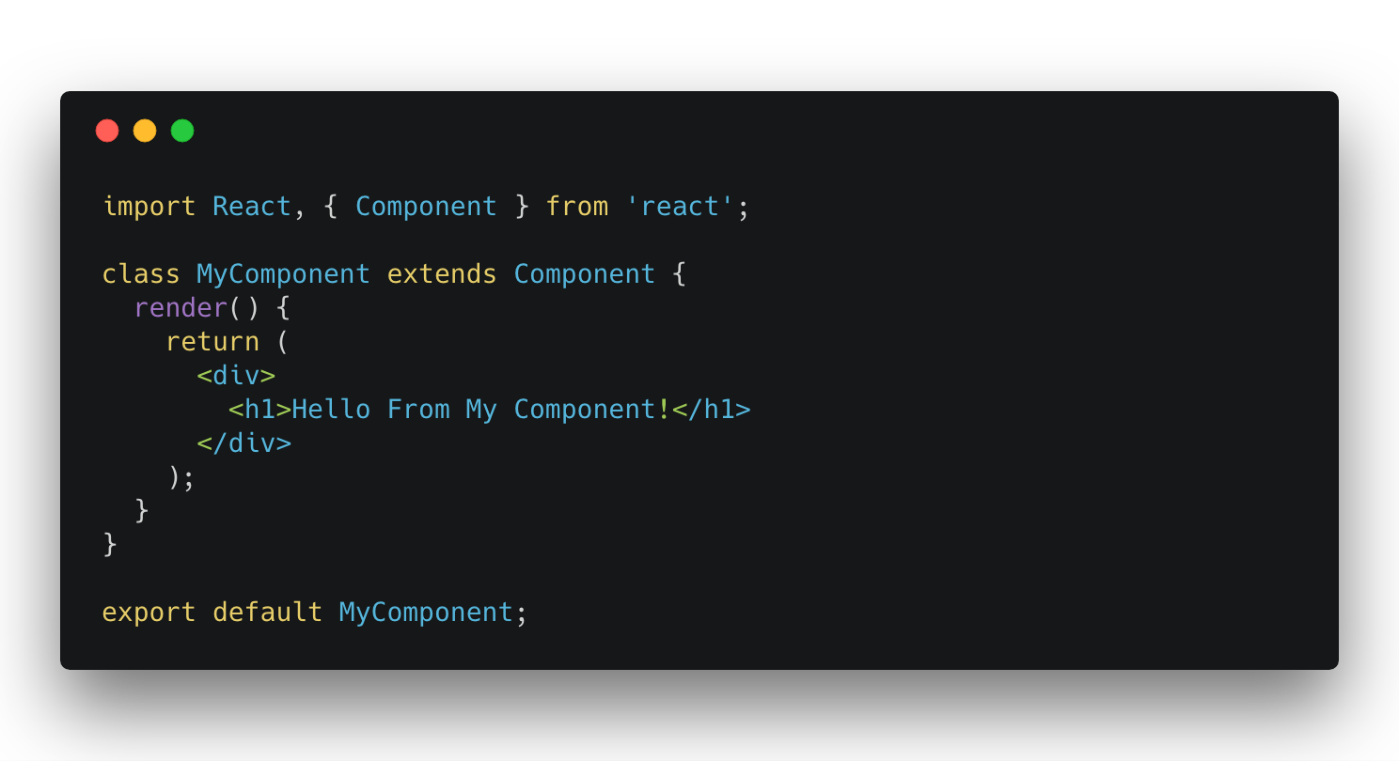
React Components
Notes:
Resources:
https://reactjs.org/docs/components-and-props.html

Slide 24
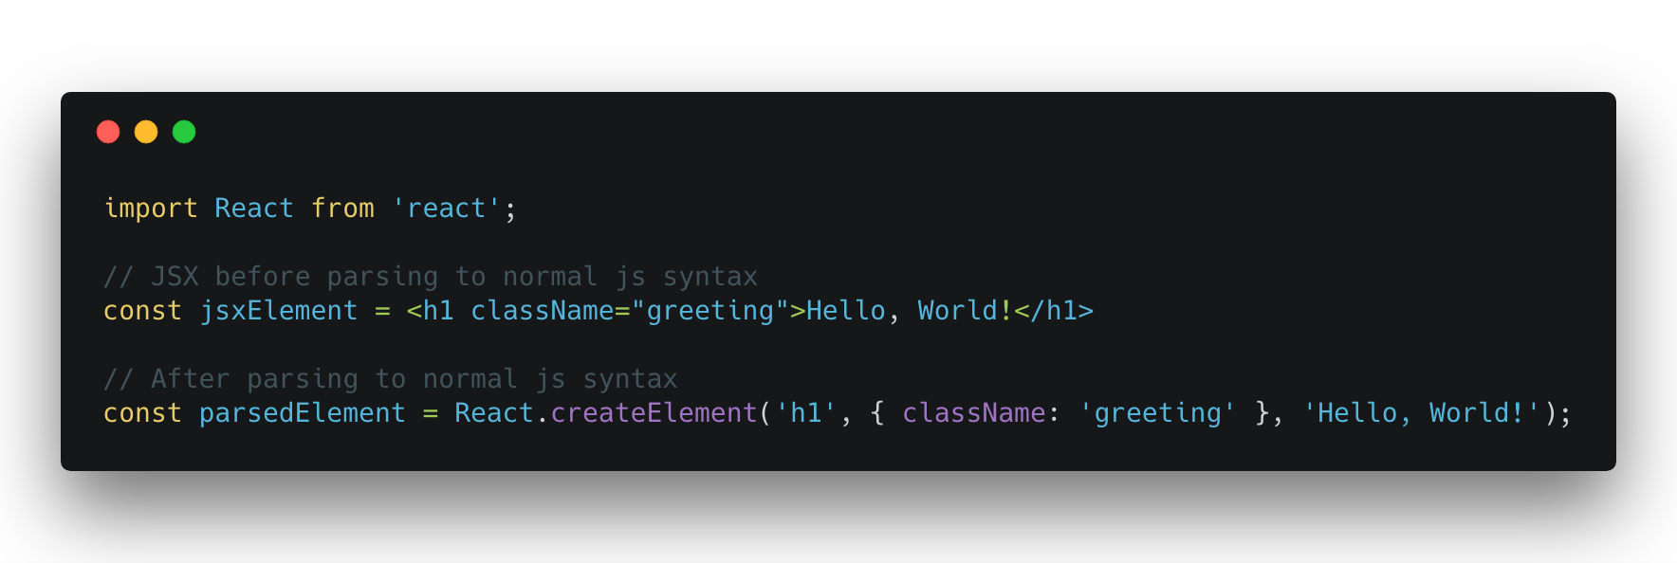
JSX
Notes:
https://reactjs.org/docs/introducing-jsx.html

Slide 25
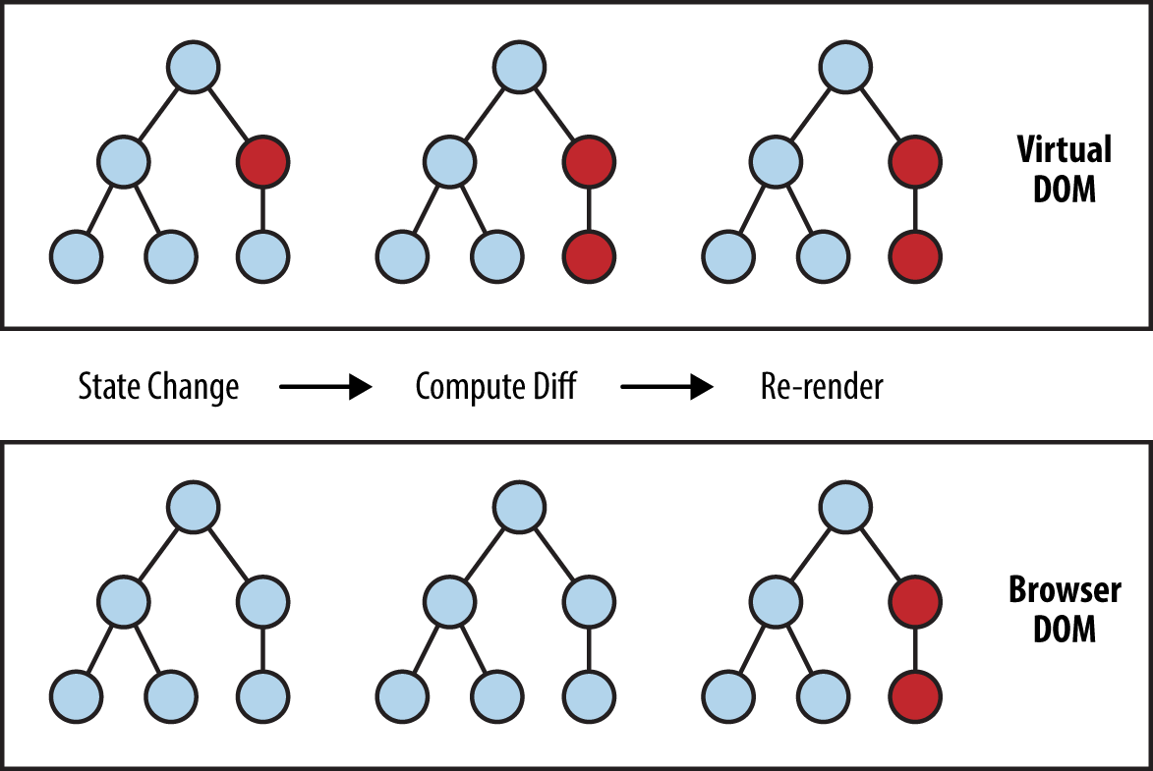
Virtual DOM
There can be no more than one component on the root level.
React.Fragment can be used if more than one component is needed on the root level.
Notes:
https://reactjs.org/docs/faq-internals.html#what-is-the-virtual-dom
https://reactjs.org/docs/fragments.html

Slide 26
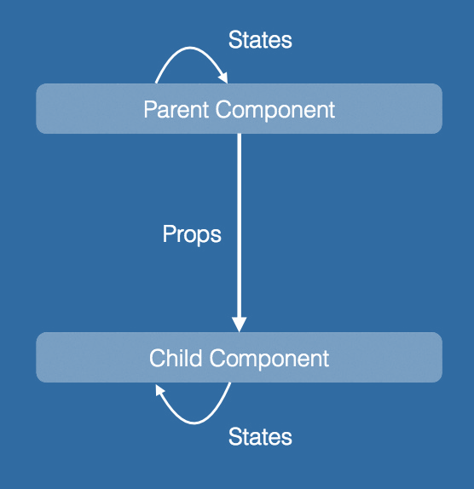
Data flow
Data flows down
Props is immutable
State is mutable
Any data can be passed to children components as props
Events flow up through handler props
Notes:
https://reactjs.org/docs/components-and-props.html#props-are-read-only
https://reactjs.org/docs/state-and-lifecycle.html
https://reactjs.org/docs/state-and-lifecycle.html#the-data-flows-down

Slide 27
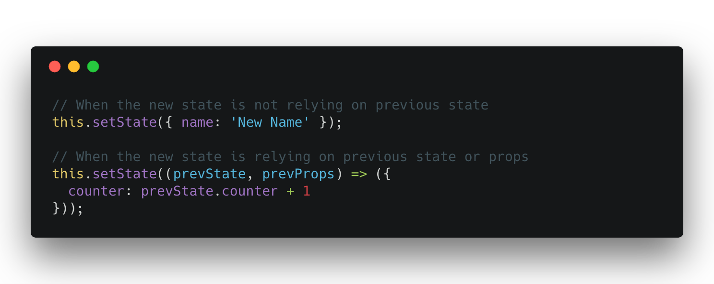
Changing the State
Notes:
setState is the only way to initiate a re-render on changing state.
DO NOT change the state directly (this.state.name = ‘new name’) as the component will not re-render
https://reactjs.org/docs/state-and-lifecycle.html#using-state-correctly
https://reactjs.org/docs/state-and-lifecycle.html#state-updates-may-be-asynchronous

Slide 28
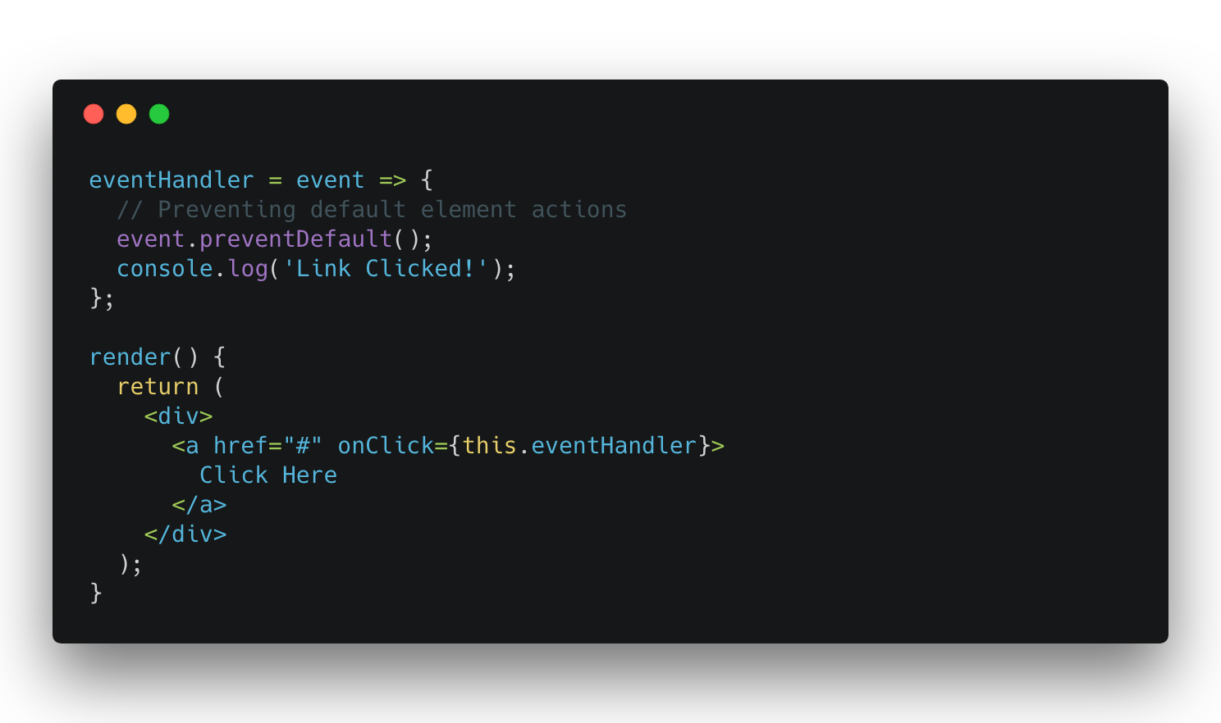
Handling Events
Notes:
https://reactjs.org/docs/handling-events.html

Slide 29
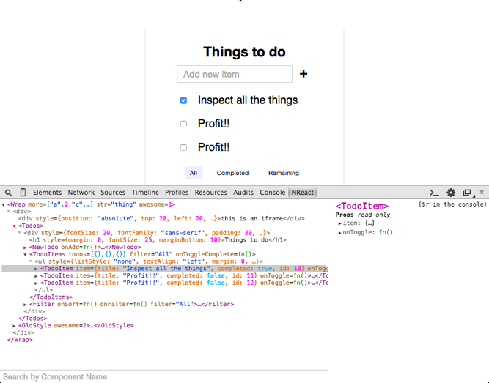
React Dev-Tools
A Chrome or Firefox extension that helps in tracking the component states, props or rendering changes.
A standalone app is available

Slide 30
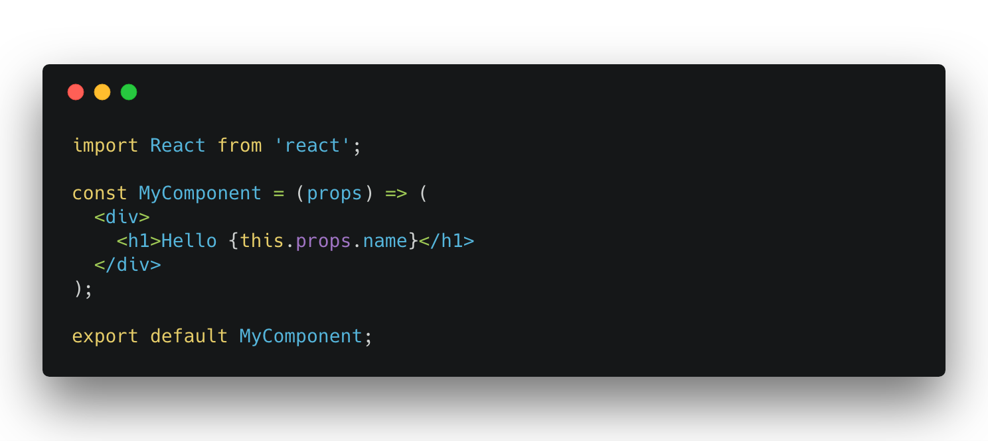
Stateless Functional Components
Notes:
Easier to read and write
Doesn’t have lifecycle methods (efficient in rendering)
Used in small components, when rendering doesn’t cost much

Slide 31
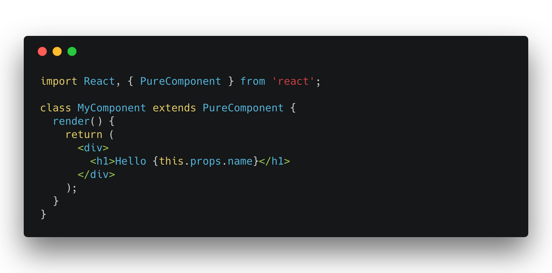
Pure Components
Notes:
Forces new logic in ComponentShouldUpdate method (Shallow comparison)
Used when Lifecycle methods or State is needed
https://medium.com/groww-engineering/stateless-component-vs-pure-component-d2af88a1200b

Slide 32
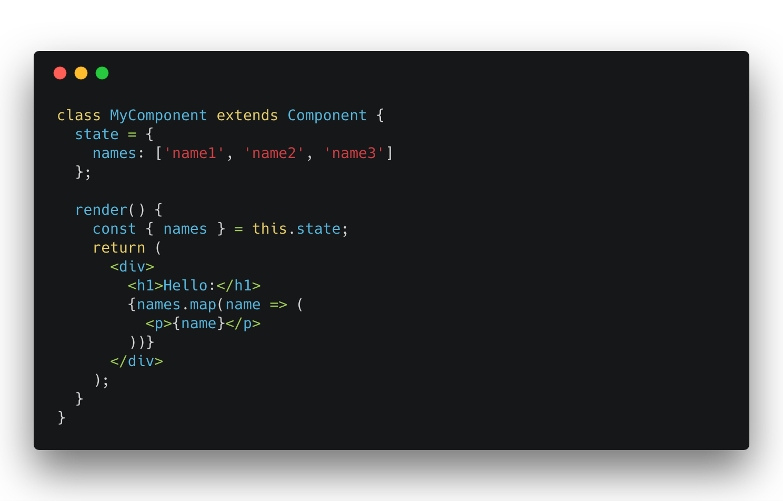
Let’s Make a List! (JS inside JSX)
Notes:
key prop is used by the Virtual DOM for rendering optimizations
If key prop is not provided React will run but generates an error in the console

Slide 33
Routing
Client side routing is different in SPAs
Special libraries are used to get the routing up and running
We’ll use: react-router-dom
npm i react-router-dom
Notes:
https://reacttraining.com/react-router/web

Slide 34
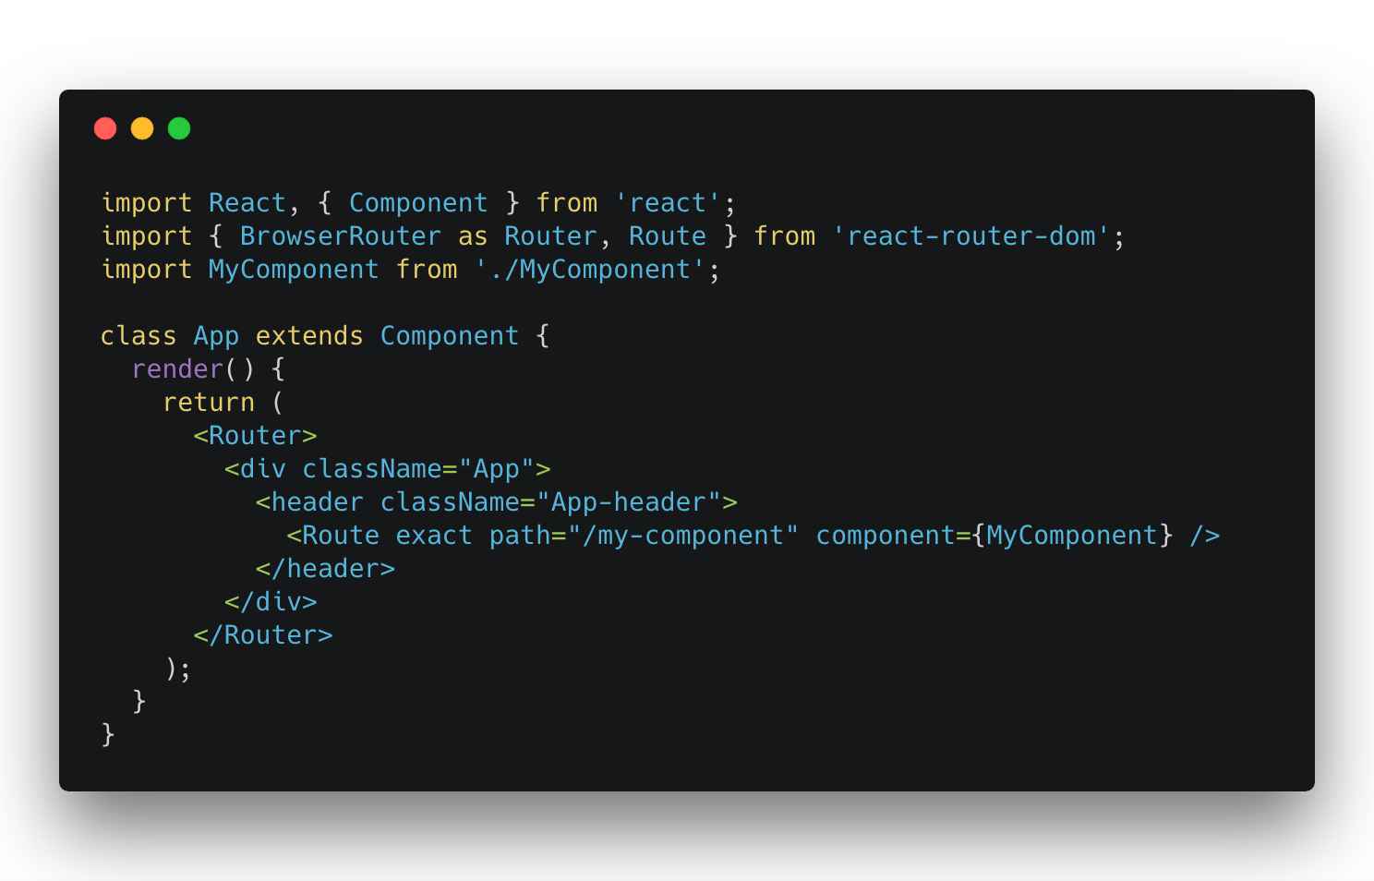
react-router-dom
Notes:
Resources:
https://seegatesite.com/tutorial-on-react-router-dom-for-beginners/#:~:text=%20React%20Router%20Dom%20Component%20%201%20Router,of%20the%20Route%20and%20will%20only...%20More%20
Explain:
Router component should wrap the App Component
Route component is used to generate the main router pages
Switch component is used to avoid rendering more than one valid path components
Redirect is used to redirect users from a path to another
Link component is used instead of a tag to move from a path to another inside the app

Slide 35
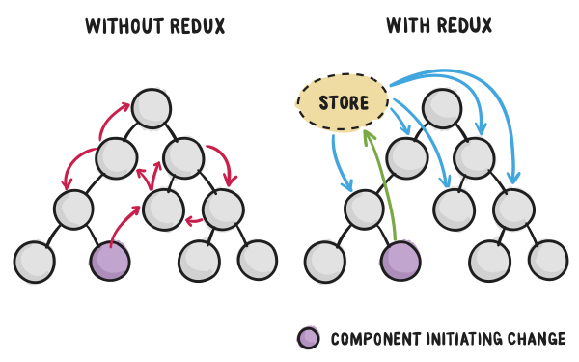
Global State Management
Redux
Flux
MobX
Context API (React 16)
Notes:
https://reactjs.org/docs/context.html
https://redux.js.org/

Slide 36
Demo Time!

Slide 38
Thank You!

